Slide 1
Vanessa Lange
Data 201 Capstone Presentation

Slide 2
As a student looking to start a new career, I am open to moving for a new job.
The data that I picked to analyze, deals with income levels in different states. I ideally would like to aim my job search to places with a higher income levels.
Describe your motivation for performing this analysis.

Slide 3
I am using two data sources for this project.
Describe your data sources.
U.S. Household Income Distribution by State
The U.S. Counties With the Highest Economic Output

Slide 4
I want to use the first data set to explore state’s income levels.
After finding that information I would like to then use the second data set to explore if there is a correlational with the highest income and the state’s economic output.
My theory is that states with a higher income will also have a high economic output.

Slide 5
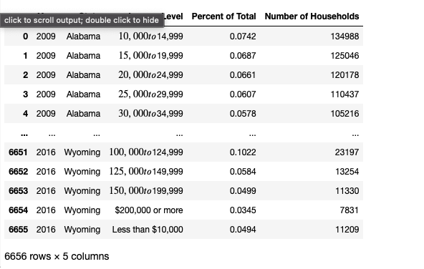

Slide 6
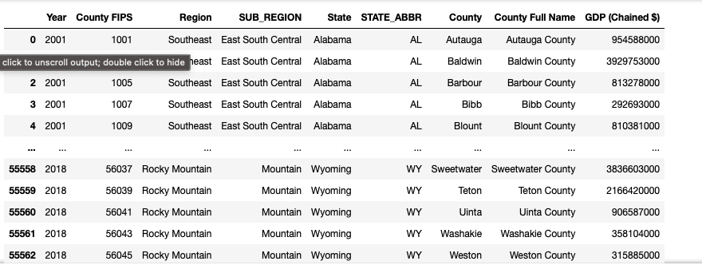

Slide 7
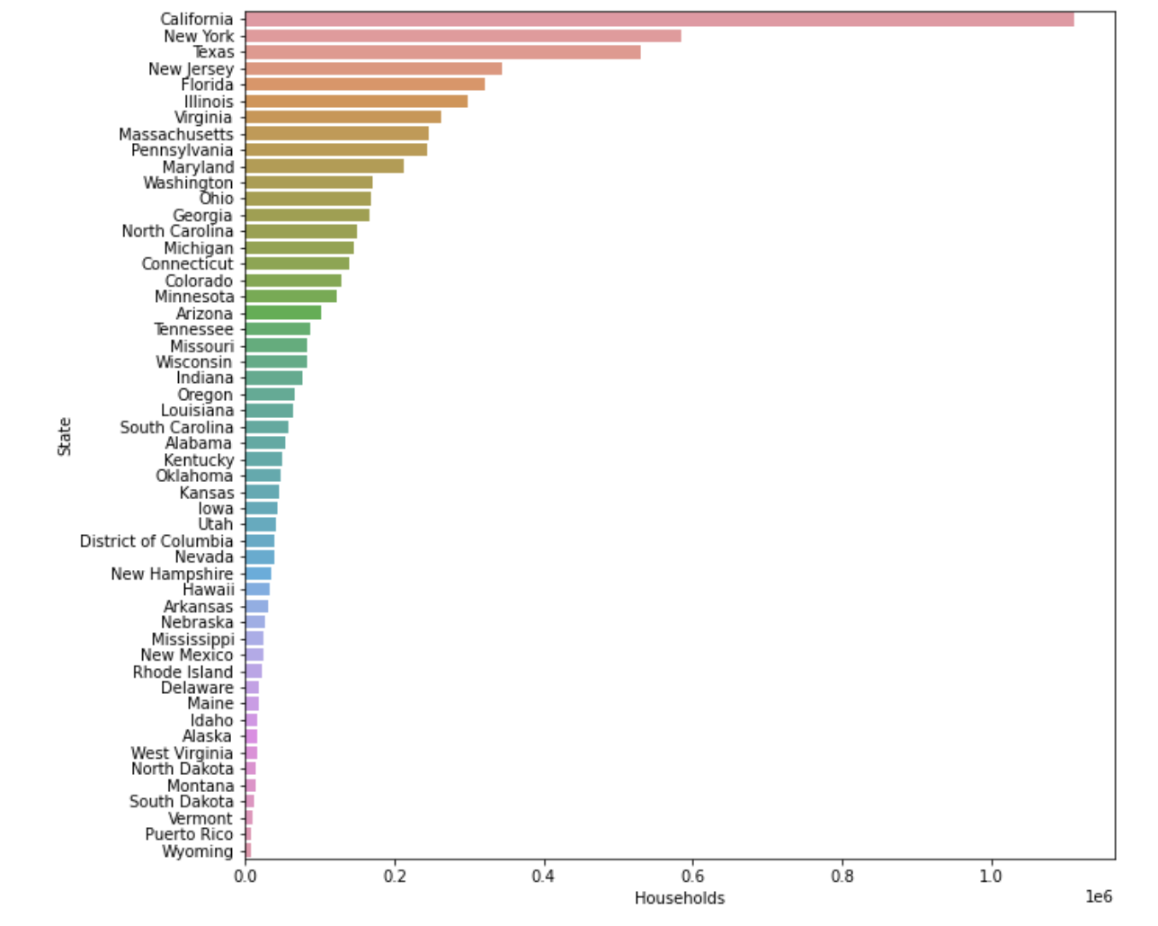
First thing I looked at were States that had the highest amount of households that made over 200,000 a year.
The Top 5 :
California - 1,110,197
New York - 584,890
Texas - 531,221
New Jersey - 343, 659
Florida - 322,098

Slide 8
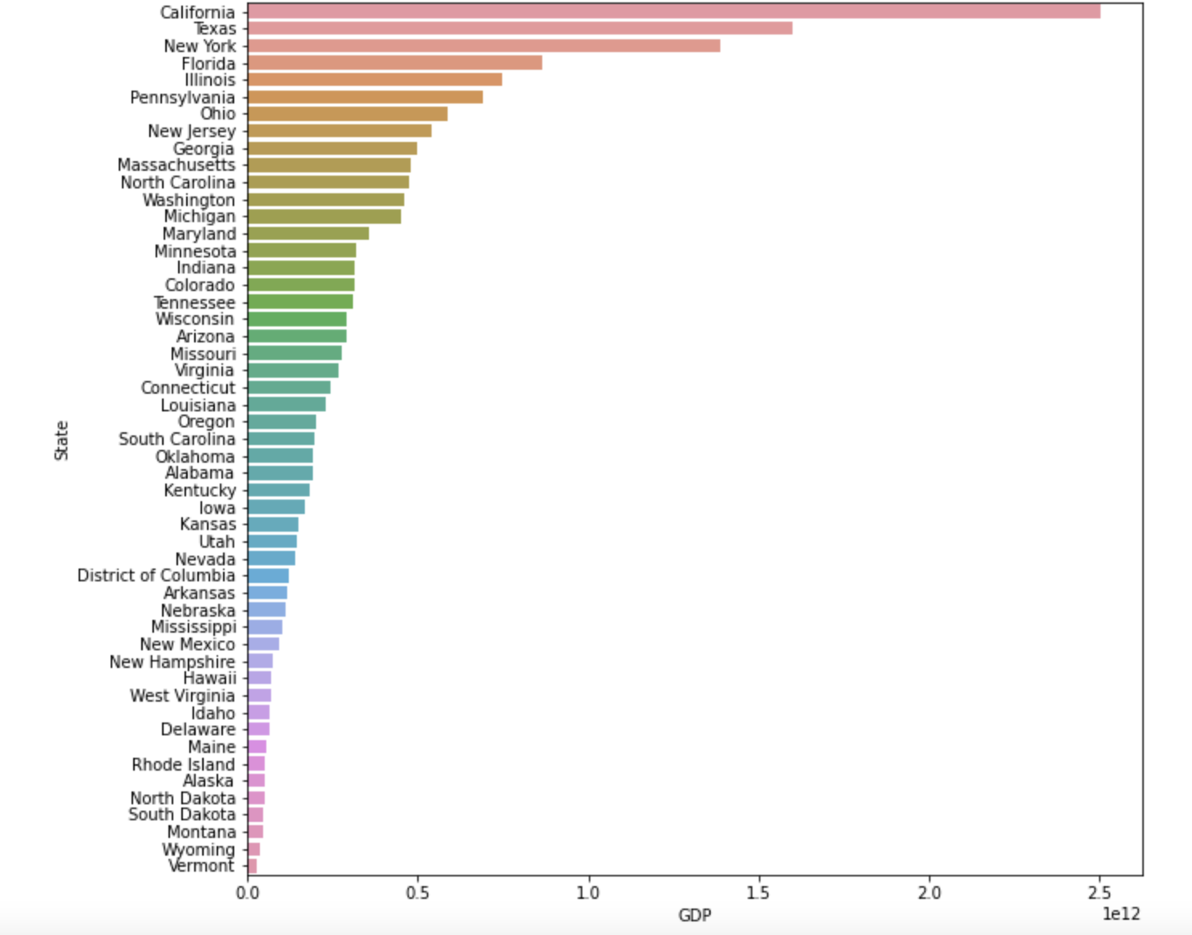
This is the GDP by State.
4 of the top 5 from the last graph included.
The Top 5:
California -2501333824000
Texas - 1599214551000
New York -1389424794000
Florida - 866737878000
Illinois - 746955291000

Slide 9
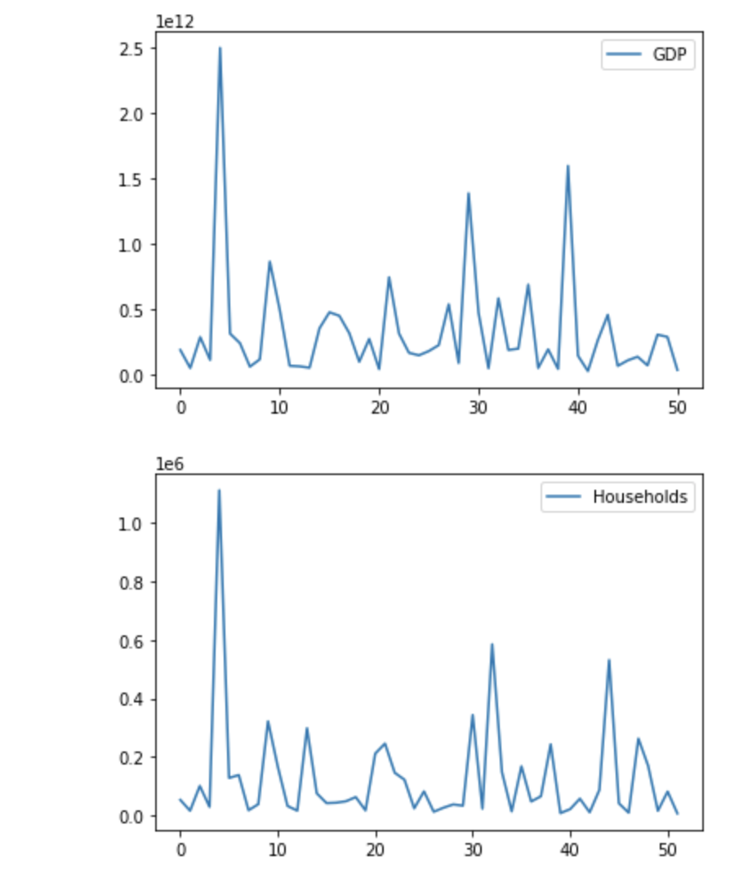
The Top graph is the state gdp and the bottom is the household income above 200,000 graph.
The graphs although not exact, are pretty similar.
This shows that there is a correlational between a states gdp and where people making the most money reside.

Slide 10
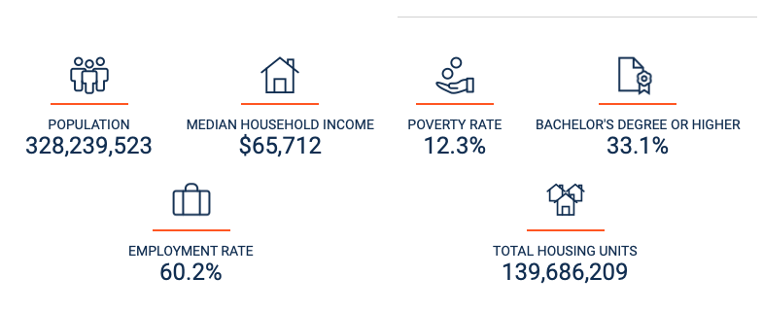
This Data is taken from the United States Census Bureau.
It shows the Median Household Income to be 65, 712.

Slide 11
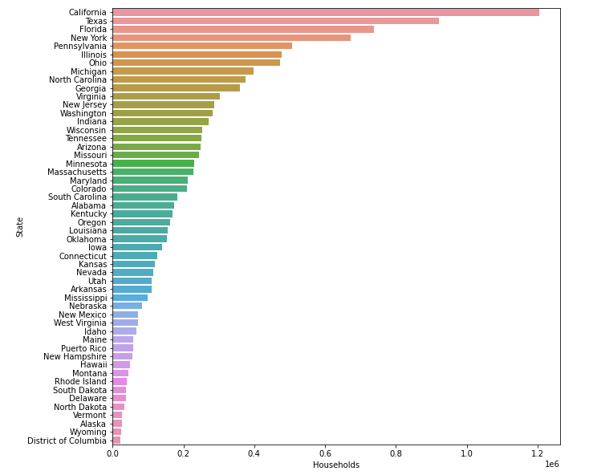
This Graph is based on households making closer to the median income level.
These Households make between 60,000 - 74,999,
The Top 5:
California - 1203377
Texas - 920198
Florida - 738333
New York- 671207
Pennsylvania - 507393

Slide 12
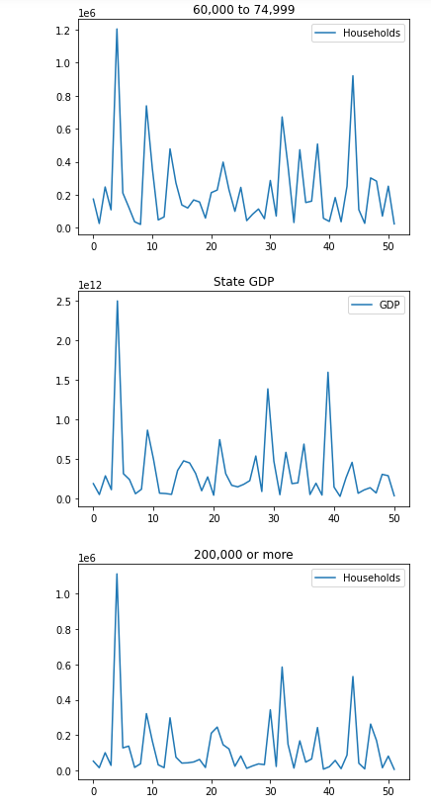
Top = 60,000 to 74,999
Middle = State’s GDP
Bottom = 200,000 or more
It seems that people making a median income also tend to live in states that have higher GDPs.

Slide 13
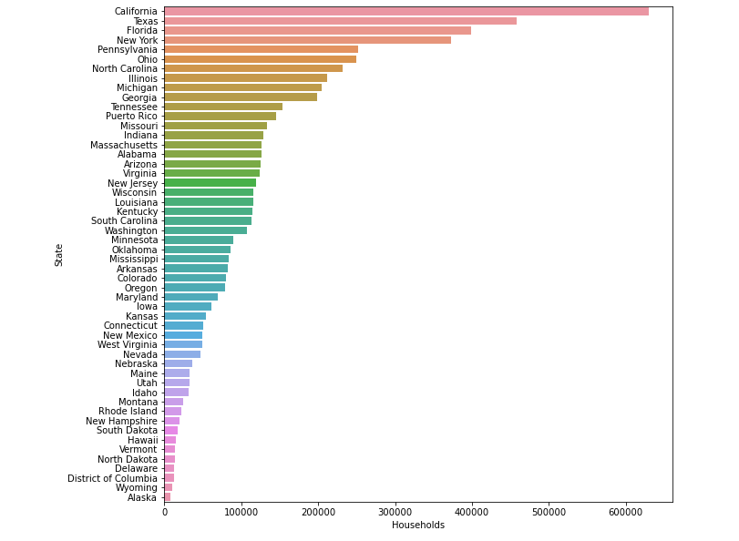
The most common income bracket was 10,000 to 14,999
It is also a much lower income bracket than the other ones we looked at.

Slide 14
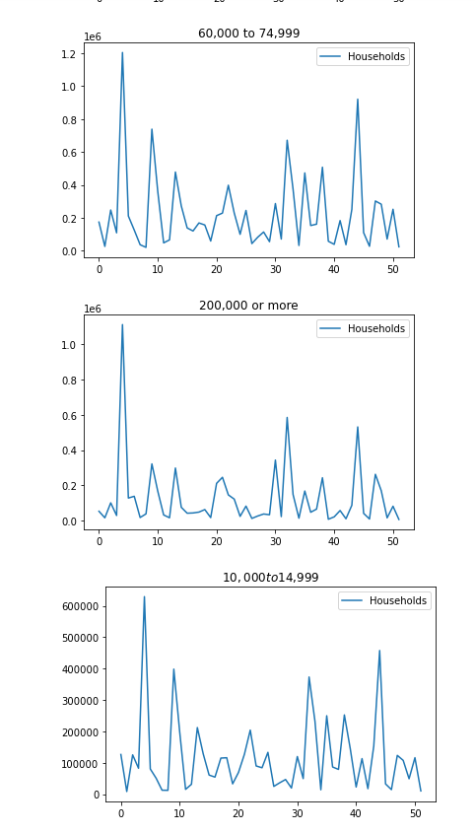
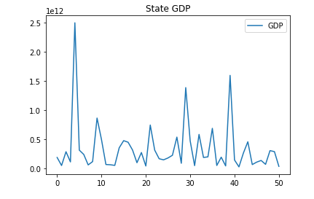

Slide 15
